Slide 1


AccuTrack
A Healthy Workforce
Daniel Weisberg | Prabal Gupta

Slide 2
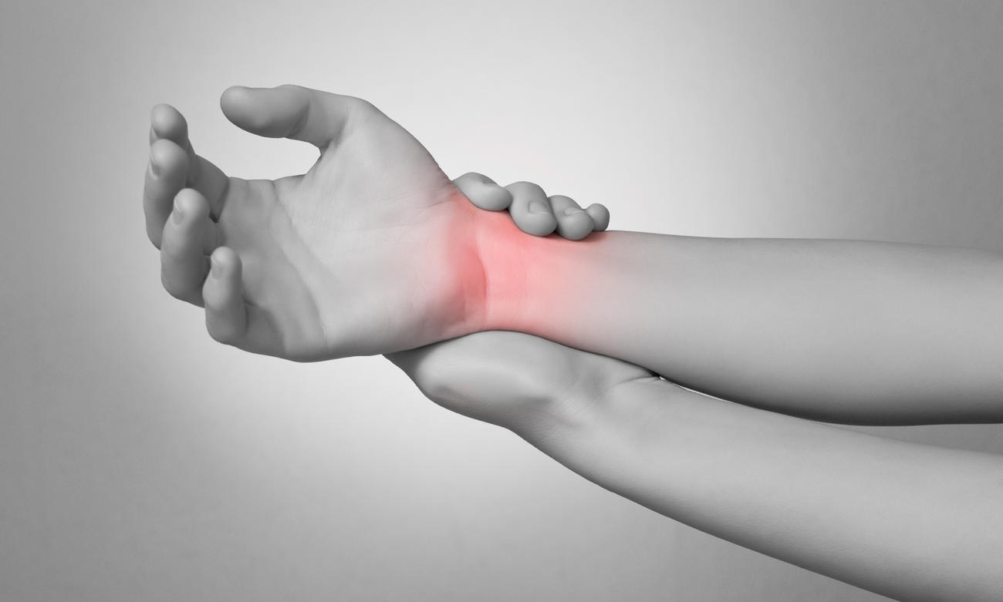
1.8 MILLION
ERGONOMIC INJURIES
IN THE UNITED STATES
EVERY YEAR

Slide 3



EXISTING SOLUTIONS
$100 BILLION
LOST IN PRODUCTIVITY,
WAGES & CLAIMS
EVERY YEAR

Slide 4
AccuTrack

Slide 5


ACCUTRACK CHIPSET
CLOUD
PIPELINE
MOBILE
NETWORK
FLEX SENSOR

Slide 6
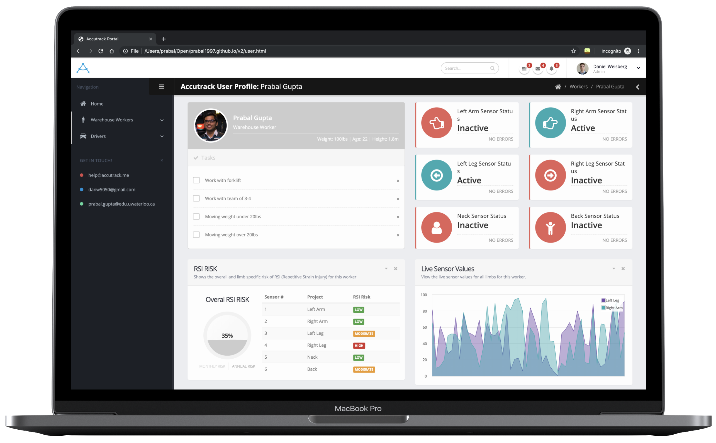
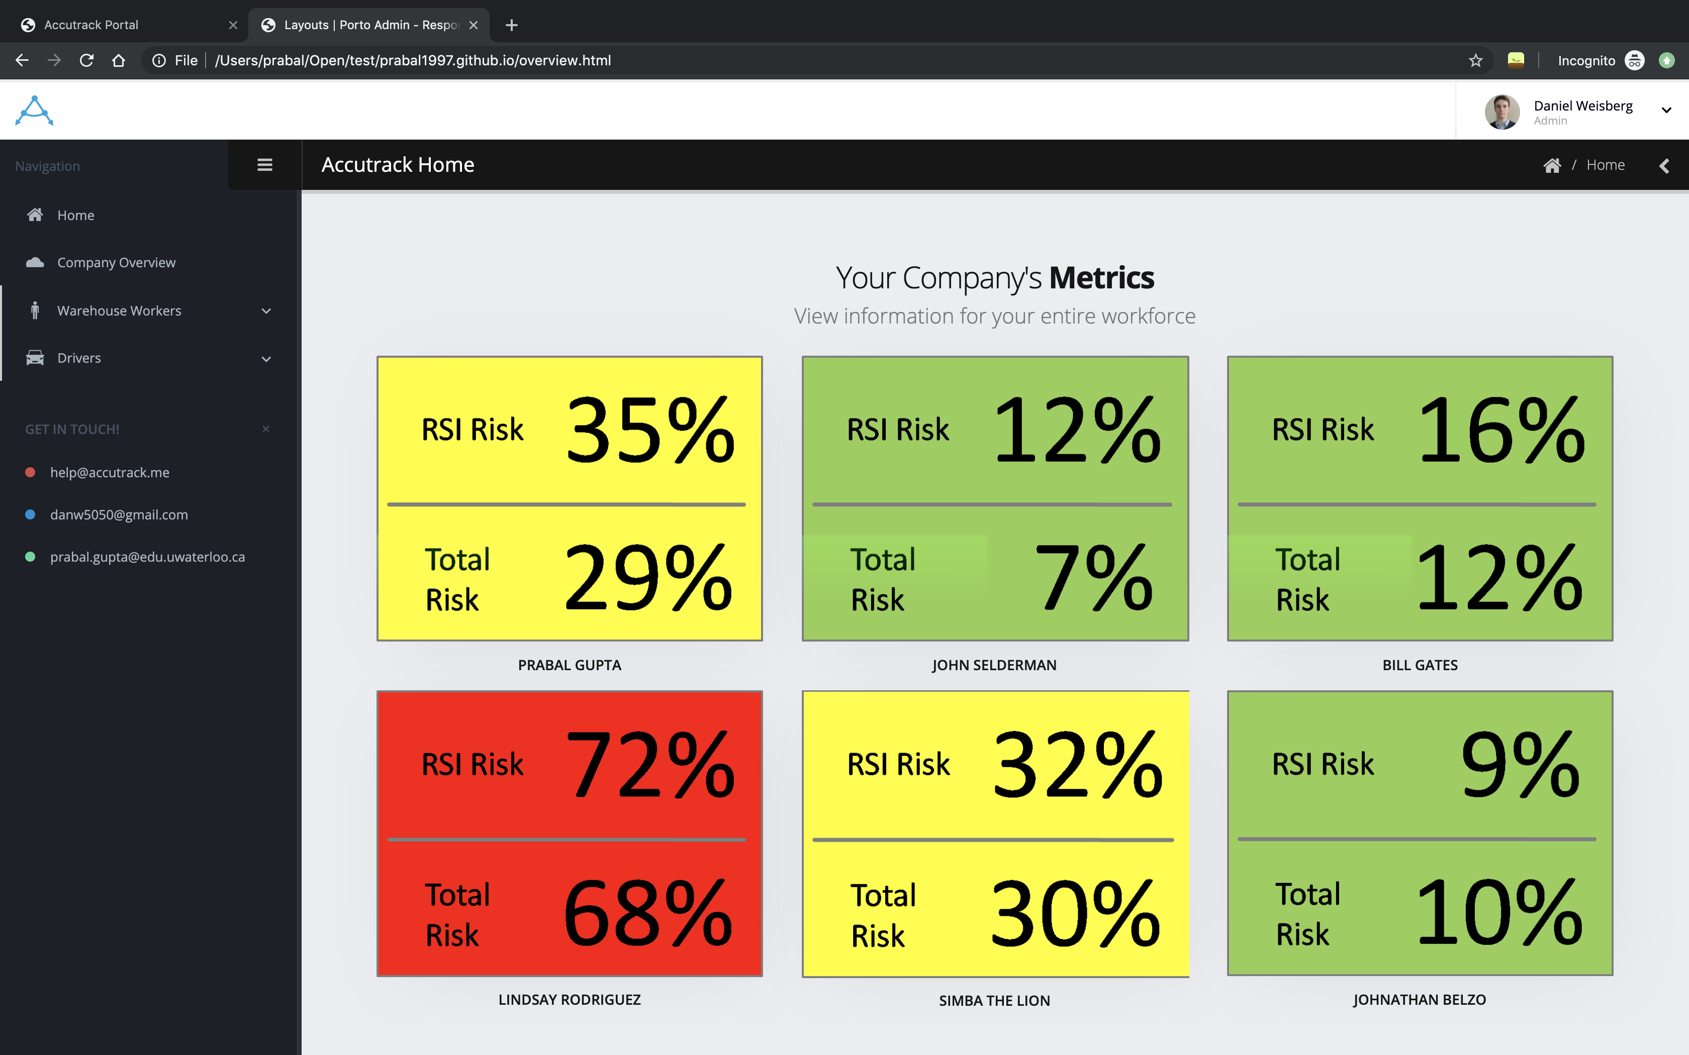

Slide 7
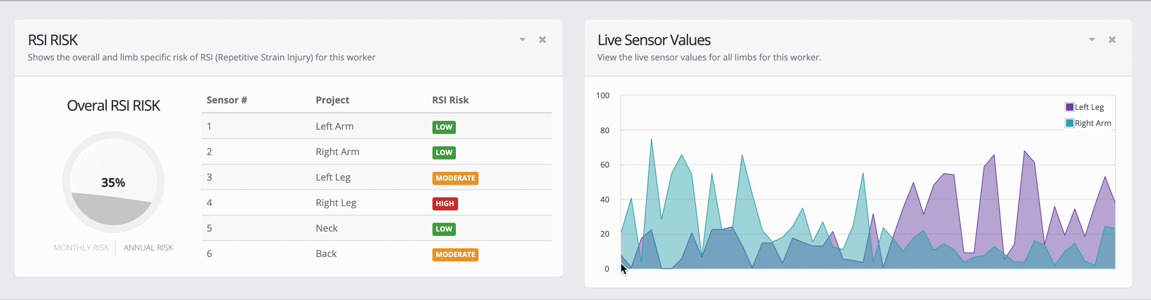

Slide 8
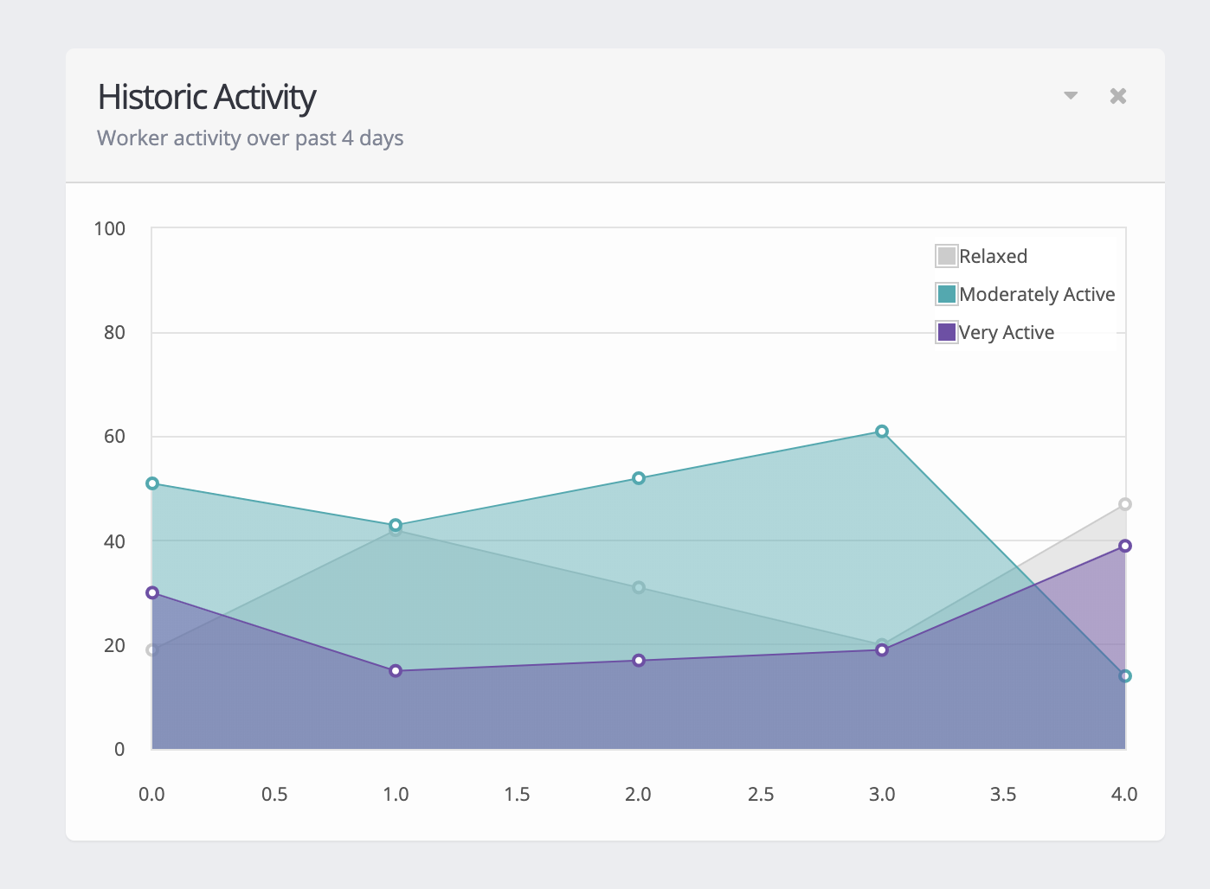

Slide 9
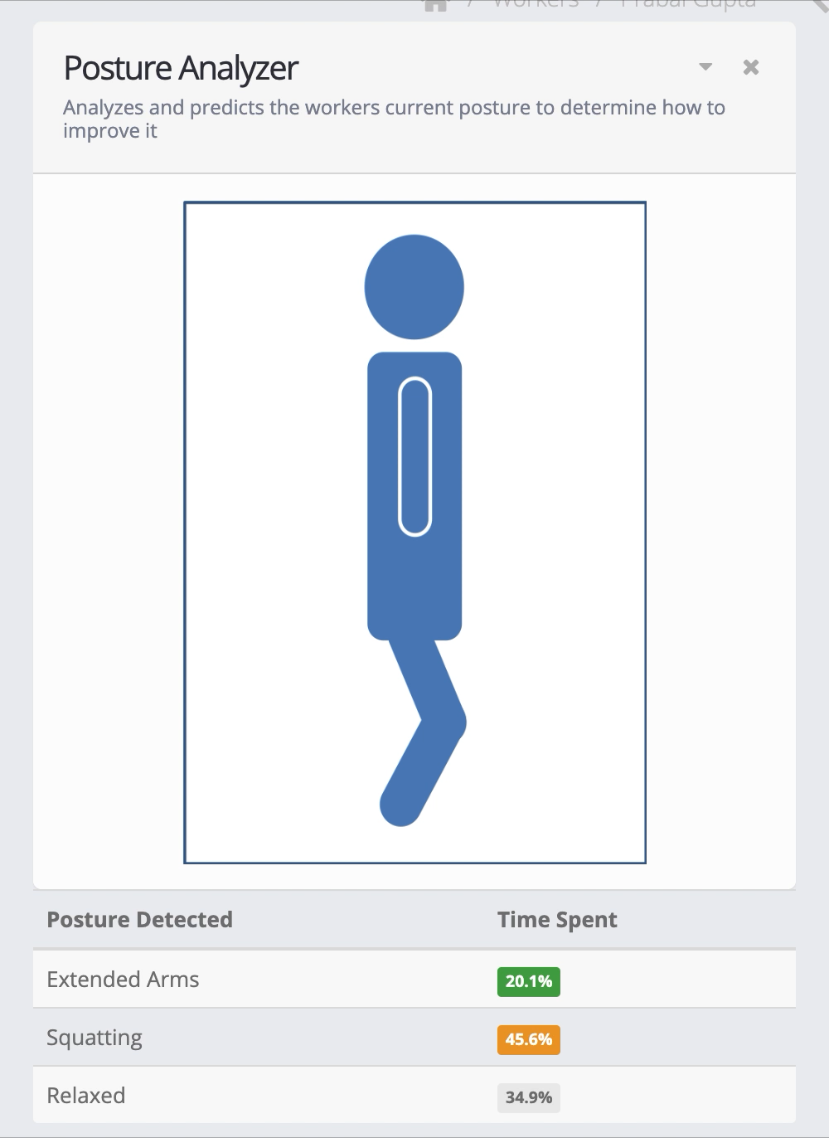

Slide 10
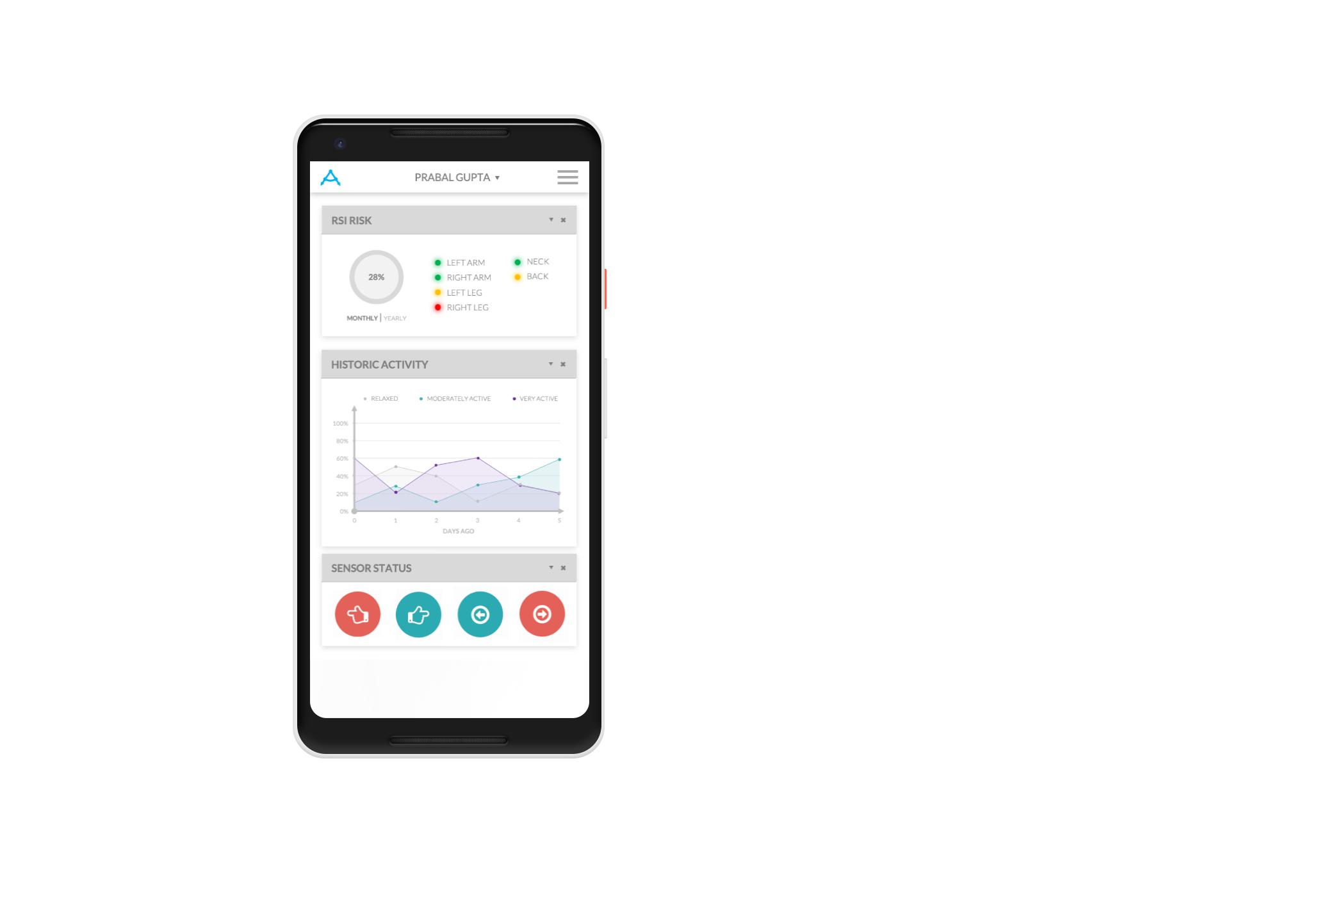
1
2
3
4
3
4
1
2

Slide 11

1
2
3
4

Slide 12




MOBILE
NETWORK
DATA
PIPELINE
AZURE
FUNCTIONS
AZURE
MACHINE
AZURE
ANALYTICS
NOTIFICATIONS
LEARNING
DATABASE
WEB PORTAL
HUB
PIPELINE
(APP SERVICE)

Slide 13
25¢
$12
OPERATIONAL
PRODUCTION
COST PER DEVICE
COST PER DEVICE
ON DAILY BASIS

Slide 14

VICTOR
PAINT

Slide 15


DR. CARL HAAS
INTERIM CHAIR, PROFESSOR,
CANADA RESEARCH CHAIR

